Slide 1
Thai Twitter Sentiment Analysis: Performance Monitoring of Politics in Thailand using Text Mining Techniques
Dhruvi Patel
1911036
Authors:Wirapong Chansanam, Kulthida Tuamsuk

Slide 2
INTRODUCTION
Social web-based life involves an enormous amount of data. Individuals can impart insights, thoughts, feelings, emotions,etc. Here Twitter plays a main role, it is a functioning site that has numerous devotees, and utilises strategy related tweets in the endeavour to speak with supporters
Estimation or conclusion examination has recently seemed one of the most investigated subjects in Natural Language Processing (NLP), chiefly for destinations like Twitter.
This paper focuses on twitter sentiment analysis of Thailand politics before 2019 elections
The paper proposes a glossy web application in R programming language to act as a passage for the investigation of tweets that depict feelings in a short.

Slide 3
Sentiment analysis
Tweets can be segmented into a number of words.
Segmented keywords can be forwarded through training datasets to compute positive and negative values .
In this paper, for an experimental analysis, they used “shiny” package (version 1.3.2) as a web application framework for R to create a TTSA shiny web application as a testing sample.
The key thought for the mapper was that they were taking the tweet, normalising the content, searching for a political watchword of enthusiasm and checking the positive and negative catchphrases.
They subtracted the proportion of negative words from the proportion of positive words and hence computed results.

Slide 4
Sentiment analysis (contd)
After grouping the information, they cleaned it by expelling some useless images and keeping just Thai content information.
This cleaning process involved 3 steps:-
Stage 1: Repeated accentuation sign standardization
In the primary phase they identified duplications of accentuation signs (".", "!" and"?").
Various rational accentuation signs are supplanted with the names "multistop" For the full stops, "multi outcry" on account of shout sign and "multiquestion" involved the question marks.

Slide 5
Sentiment analysis(contd)
Stage 2: Lower packaging and tokenization
The tweets were lowercased and isolated into tokens, in view of spaces and accentuation signs.
Stage 3: Word standardization
In this stage, the tokens were matched with passages in the dictionary.
In the event that no match was discovered, rehashed letters were diminished in grouping to two or one until a match was found in the word reference.

Slide 6

Data
Information gathering and pre-handling Twitter channels from twitter.com were acquired.
The 10,000 tweets from twitter.com were comprised of assessments about the Thai political race in 2019.The language of the twitter channels was Thai and English.
For scoring of the sentiment of tweets, an all-out feeling score was determined. The all-out opinion score for a tweet was equivalent to the whole notion score of each word times the quantity of the occasions the word was spoken
i.e:-
where denotes the total sentiment score for a tweet, is the sentiment score of a word n and is the number of times word n appears in a tweet.
A tweet score was changed over to a basic positive/negative scoring framework (-1, 0, +1) for complete positive, nonpartisan, and negative scores respectively.

Slide 7
Related work
Shiny app: Thai twitter sentiment analyser
Shiny is a package in R language for designing web applications.
They made a glossy application connected with ongoing information so individuals can have new outcomes.
In this application, the tweets were be naturally refreshed at regular intervals and all information was classified as negative,positive or neutral. Under every class, constructed a word cloud to exhibit mainstream words.
They used the “wordcloud2” package (version 0.2.1) to create a word cloud with an 'htmlwidget' library. This package provides an HTML5 interface to wordcloud for data visualization.
They utilised the "content" section from the tweet_doc article to make a word lexicon of the tweets subsequent to evacuating accentuation and undesirable characters.

Slide 8
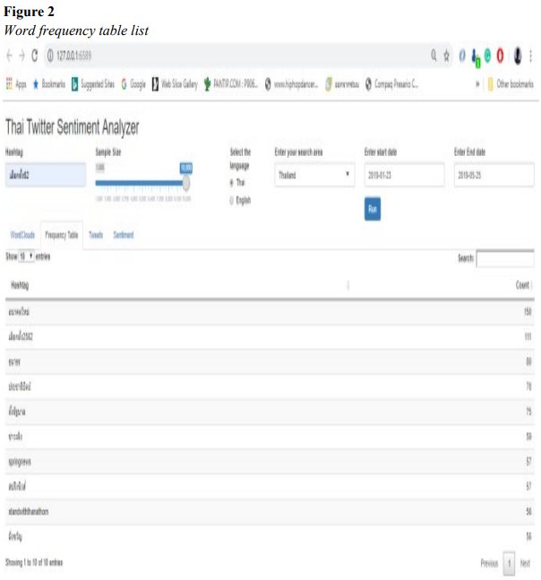
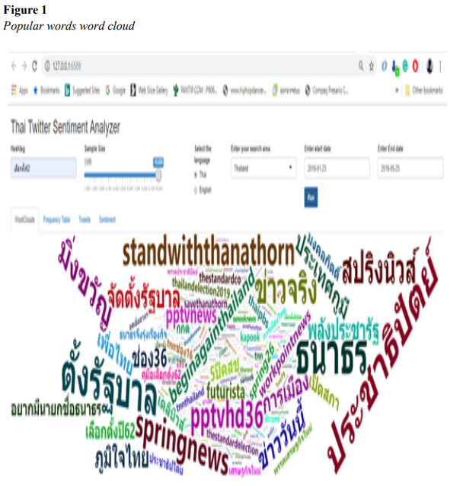
Related work (continued)
The picture below shows such a word cloud with featured words demonstrating high-recurrence phrases.

Slide 9
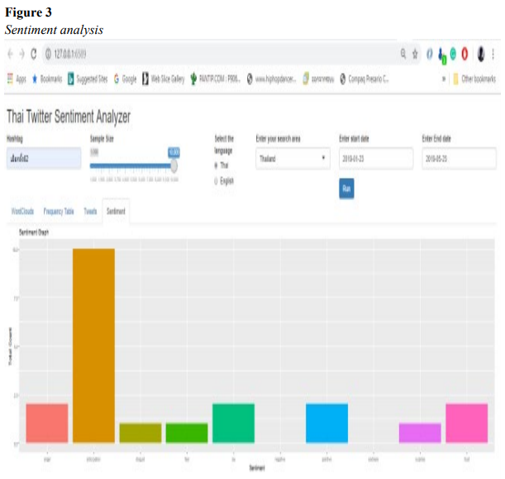
Plotting of sentiment graph

Slide 10
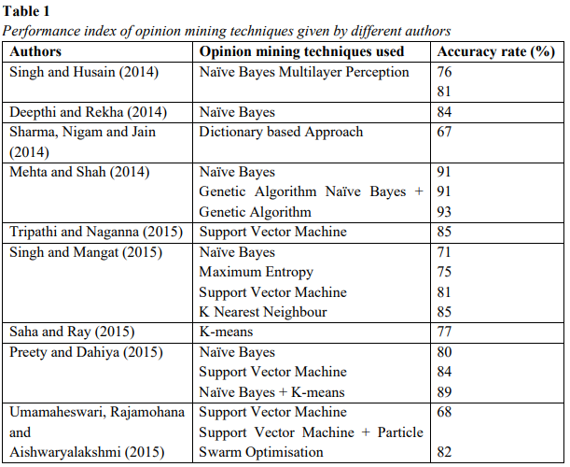
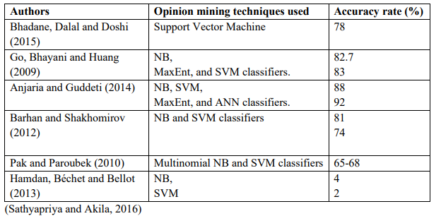
Related work(contd)
There are many more applications and improvements on opinion mining and sentiment analysis algorithms. These surveys give several sentiments or opinion mining techniques and their accuracy is given by authors, as shown

Slide 11
Conclusion
This paper shows that the TTSA shiny web application framework performs very well regarding the arrangement of the feelings of client tweets with high precision.
It executed fluffy capacities to imitate the impact of different etymological fences.
Conclusion mining or estimation examination is a significant job in content mining applications. It involves to breaking down pearls of information from a huge volume of individual input and about remarks or tweets of any article, political decision or vote.
This paper offered numerous assessments or sentiments in terms of mining strategies, levels, and sorts. These are applied by the creators and exactness is delivered.

Slide 12
Idea of Implementation
I will be using python instead of R language.
I will take dataset from Kaggle regarding Indian politices instead of thai poitics.
Perform text mining,cleaning and sentiment analysis on that dataset
Using vader lexicon for the same
Plotting graphs
Making word cloud

Slide 13
Acknowledgement
This research is supported by the Digital Humanities Research Group (DHRG), Khon Kaen University, Thailand.
References:-
International Journal of Innovation, Creativity and Change. www.ijicc.net Volume 11, Issue 12, 2020.Thai Twitter Sentiment Analysis: Performance Monitoring of Politics in Thailand using Text Mining Techniques
Kaggle.com
Anjaria, M., Guddeti, R. M. R. (2014). Influence factor based opinion mining of Twitter data using supervised learning. In Proceedings of 2014 Sixth International Conference on Communication Systems and Networks (COMSNETS), 1-8.
barhan, A., Shakhomirov, A. (2012). Methods for sentiment analysis of Twitter messages. In Proceedings of 12th Conference of FRUCT Association.
Bhadane, C., Dalal, H., Doshi, H. (2015). Sentiment analysis: Measuring opinions. Procedia ComputerScience, 45, 808-814.
Deepthi, G., Rekha, K. S. (2014). Opinion mining andclassification of user reviews in social media, International Journal of Advance Research in Computer Science and Management Studies, 2, 37-41.

Slide 14
Thank You

